Slide 1


Department of Electronics and Communication Engineering
Voice-Based Gender Identification
Sl.No | Name | SRN
1 | SAKSHI DODWAD | 02FE22BEC074
2 | SACHIN SIDNAL | 02FE22BEC073
3 | SHREYA KADAKOL | 02FE22BEC089
4 | VINOD YALLUR | 02FE22BEC117
Under the Guidance of
Dr. PRABHAKAR MANAGE

Slide 2
INDEX
Problem statement
Introduction
Literature review
Data Set
Block daigram
Specifications of signal involved in project and sources
Timeline of project
Conclusion
Reference

Slide 3
Problem Statement
Problem statement: Voice-Based Gender Identification
Designing and implementing a gender recognition system through voice analysis using Digital Signal Processing (DSP) techniques to enhance accuracy and efficiency in gender classification.

Slide 4
Introduction
Gender recognition using voice is a fascinating field of study that focuses on the development of algorithms and techniques to identify the gender of a speaker based on their vocal characteristics.
Voice signals carry distinct characteristics that differentiate between male and female speakers. These differences include fundamental frequency (pitch), formant frequencies (resonance frequencies of the vocal tract), and other acoustic features like voice quality and duration.

Slide 5
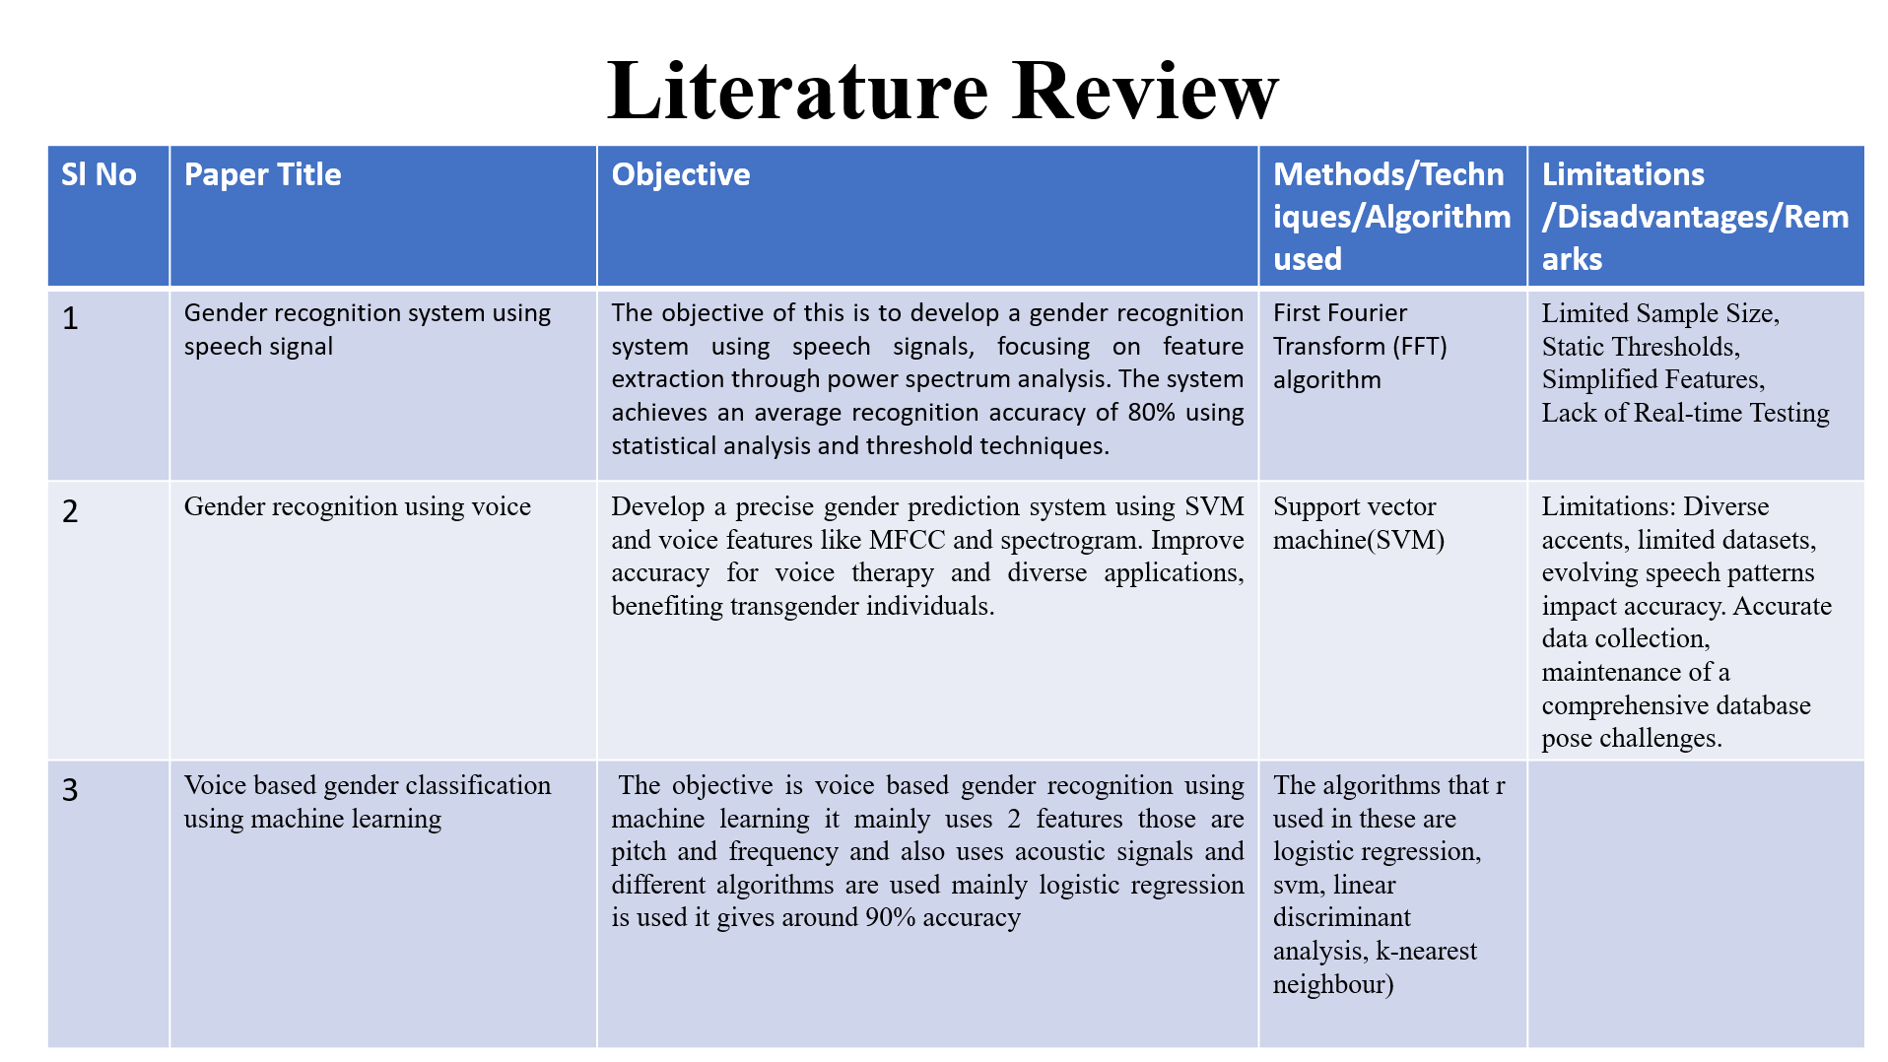
Literature Review
Limited Sample Size, limited dataset,lack of Real-time Testing

Slide 6
Literature Review
Sl no. | Paper Title | Objective | Methods/algorithms/techniques used | Limitations
4 | Voice-Based General Identification Systems: A Survey of Techniques, Applications, and Challenges | This study aims to review existing techniques for voice-based identification systems, explore their applications in fields like security and healthcare, and analyze challenges such as noise interference and privacy concerns. It evaluates system performance, identifies research gaps, and proposes future directions for improvement while emphasizing ethical and real-world implications. | MFCC, SVM, CNN, RNN. | Limitations: Noise, variability, data needs.Disadvantages: Privacy risks, spoofing, accuracy issues.Remarks: Improved by deep learning, but challenges remain.

Slide 7
Dataset
To work on this task we will need a dataset that includes audio signals with associated gender labels.

Slide 8
Block Diagram
Speech signal
Drive data from recorded wave sound
FFT
Plotting the single sided amplitude spectrum
Displaying a message indicating gender

Slide 9
SPECIFICATIONS OF SIGNAL INVOLVED IN PROJECT AND SOURCES
Specifications of the Signal
Amplitude: The amplitude of a voice signal represents the loudness or intensity of the sound.
Frequency: Voice signals consist of a range of frequencies. The human voice typically spans from approximately 85 Hz to 255Hz.
Pitch: Pitch is related to the fundamental frequency of the voice signal and determines whether the voice sounds high- pitched or low-pitched.

Slide 10
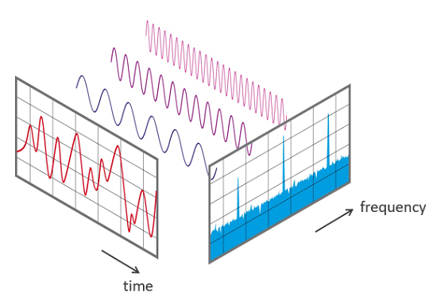
Fast Fourier Transform
The Fast Fourier Transform (FFT) in Digital Signal Processing (DSP) is an algorithmic technique used to efficiently compute the Discrete Fourier Transform (DFT) of a sequence, typically a digital signal.
FFT allows us to convert a signal from its time-domain representation into its frequency-domain representation.
FFTs are used for fault analysis, quality control, and condition monitoring of machines or systems.
<
>
a) View of signal in the time and frequency domain

Slide 11

Timeline of project

Slide 12
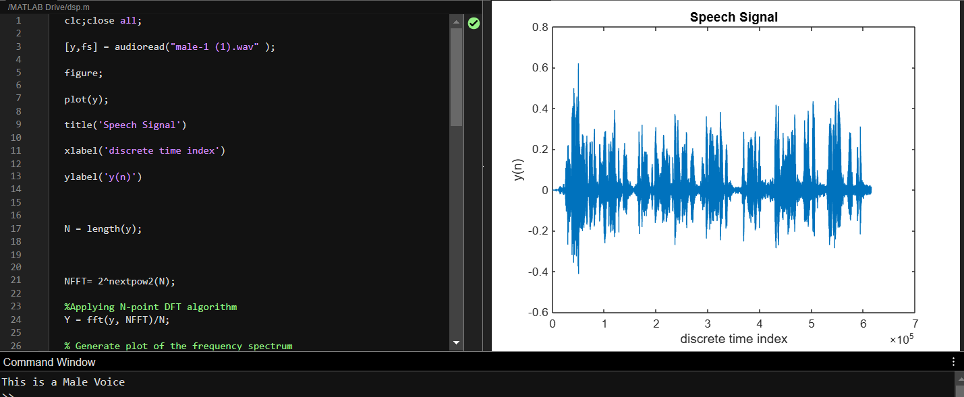
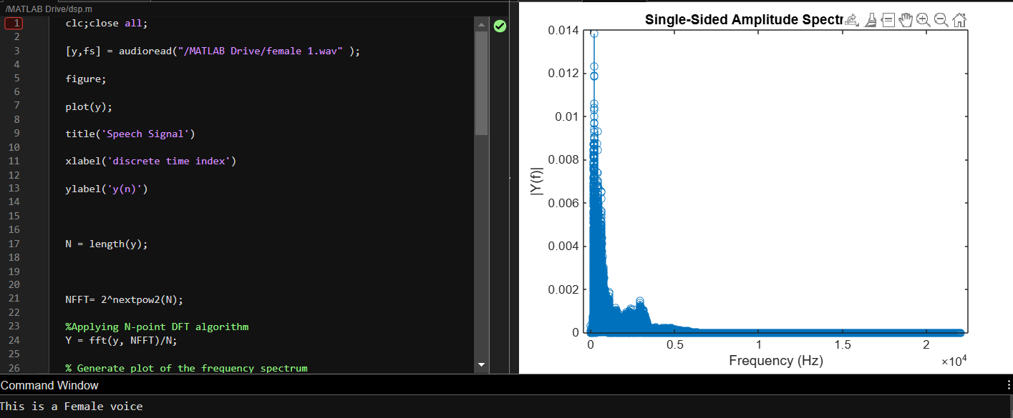
RESULT:

Slide 13
Conclusion
*This project demonstrates the importance of DSP in speech recognition at a simple level. Clearly, this is possible because of the Fast Fourier Transform which is of extensive use in modern day technologies in the whole domain of signal processing.

Slide 14
Reference
Gender Recognition System Using Speech Signal This study utilizes Fast Fourier Transform (FFT) and power spectrum analysis for gender classification through speech signals. A system is developed to analyze frequency characteristics for identifying gender with about 80% accuracy. Reference:
Kumar, M., & Prakash, C. (2012). Gender Recognition System Using Speech Signal. International Journal of Computer Science, Engineering and Information Technology (IJCSEIT), 2(1), 3-15​
ResearchGate.
Gender Recognition Using Voice This work leverages Support Vector Machine (SVM) alongside voice features like MFCC for accurate gender prediction, particularly helpful for voice therapy applications. Reference:
Buyukyilmaz, O., & Cibikdiken, A. O. (2021). Voice Gender Recognition Using Acoustic Features, MFCCs, and SVM. Springer, pp. 241-251​
ResearchGate.
Voice-Based Gender Classification Using Machine Learning This paper investigates machine learning algorithms (Logistic Regression, SVM, etc.) on acoustic signals to classify gender with high accuracy, focusing on pitch and frequency features.
Reference:Chen, K. (2020). Gender Identification by Voice. Stanford University, cs229.stanford.edu.

